Slide 1
Speeding up Generalized Fuzzy k-Means Clustering Using m Nearest Cluster Centers Algorithm on GPU
利用GPU及m最近群中心加速廣義模糊k均值分群演算法
研 究 生：武亭忠 Student：Dinh-Trung Vu
指導教授：賴榮滄 Advisor：Zone-Chang Lai

Slide 2
Abstract
Implement parallel “Generalized Fuzzy k-Means Clustering Using m Nearest Cluster Centers” (PGFKM) on a GPU
PGFKM algorithm: about 3 to 18 times faster than the optimized CPU code.

Slide 3
introduction
GFKM: less computing time and better clustering quality than FKM
GFKM running time: grows with the increase of size and dimensionality of data set
Focus on the size of data set.

Slide 4
organization
PGFKM Model
Updating Membership Step
Calculating New Centroids Step
Checking Convergence Step
Experimental Results.

Slide 5
PGFKM MODEL
CPU
GPU
Initialize Centroids
Update Membership
Small data set
Calculate new Centroids
Large data set
Calculate new Centroids
Left small data blocks
Check Convergence
No
Results
Yes

Slide 6
Updating membership on CPU
DNNT : M nearest distances responding to NNT_{i}
For each data point X_{i}
For each centroid C_{j}
Update membership for data point X_{i}
Calculate distance d(X_{i}, C_{j})
Update NNT_{i} and DNNT

Slide 7
Updating membership on GPU
N data points → N threads working in parallel
Each thread loads the corresponding data point → on-chip registers
Each thread writes < 5 values to shared memory (SM) : use SM broadcast centroids → thread block
Otherwise, threads are read the same centroids in global memory (GM).

Slide 8
Updating membership on GPU
gridDim = N / blockDim
Thread T_{i}
i = blockIdx.x * blockDim + threadIdx.x;
For each C_{j} in GM
Load X_{i} → on-chip registers
Calculate distance d(X_{i}, C_{j})
Update memberships for X_{i}
Update NNT_{i} and DNNT

Slide 9
Updating membership on GPU
gridDim = N / blockDim
Thread T_{i}
i = blockIdx.x * blockDim + threadIdx.x
Load centroid
GM → SM → synchronize threads
For each C_{j} in SM
Calculate distance d(X_{i}, C_{j})
Load X_{i} → on-chip registers
Update NNT_{i} and DNNT
Update memberships for X_{i}

Slide 10
Calculating new centroids on CPU
N is small: number of active threads in parallel is small → GPU is inefficient → CPU is still used
The computational complexity : O(NMd + kd).

Slide 11
Calculating new centroids on CPU
SumU_{j} : sum of memberships of C_{j}
For each X_{i}
For each centroid index j in NNT_{i}
For each C_{j}
C_{j} = C_{j} + U’_{i,j}^{q} * X_{i}
C_{j} = C_{j} / SumU_{j}
SumU_{j} = SumU_{j} + U’_{i,j}^{q}

Slide 12
Calculating new centroids on GPU
N is large, k is close to M : design PGFKM using equation of FKM
The computational complexity : O(Nkd + kd)
Having un-coalesced data access
To achieve coalesced data access, using cuBLAS library:
transpose data points from N×d to d×N,
transpose memberships from N×k to k×N.

Slide 13
Calculating new centroids on GPU
Un-coalesced data access

Slide 14
Calculating new centroids on GPU
Coalesced data access

Slide 15
Calculating new centroids on GPU
Reduce U_{i,j}^{q} for the jth cluster
Reduce U_{i,j}^{q} * X_{i} for the jth cluster and the xth dimension.
Executed concurrently or interleaved in six different streams.
Small output block sums: reduced very fast on CPUs.

Slide 16
Calculating new centroids on GPU
CPU
GPU
Transpose data points and memberships
For j = 1 to k
Small block sums
Reduce new centroids
Stream #1 reduces U_{i,j}^{q}
For x = 1 to d
Stream #(x mod 5 + 1) reduces U_{i,j}^{q} * X_{i}

Slide 17
Calculating new centroids on GPU
N is relatively large, and k is not close to M : using equation of GFKM
Reduce un-coalesced data accesses : transpose data from N×d to d×N
Reduce un-coalesced membership accesses : sort NNT with keys (cluster indices), values (point indices, memberships).

Slide 18
Calculating new centroids on GPU
Sorting array NNT has two scenarios :
(1) using the GPU-based counting sort algorithm
(2) using the stable sort by keys of Thrust library in CUDA Toolkit
Scenario (1) : the histogram of NNT is calculated first

Slide 19
Calculating new centroids on GPU
Histogram write conflicts: a lots of threads with the same cluster index increase the histogram array.

Slide 20
Calculating new centroids on GPU
Calculating the histogram of NNT
(gridDim = (N * M) / blockDim)
Thread T_{i}
atomicAdd(histogram(NNT(i)), 1)
Thread T₀
For i = 1 to k
scan(i + 1) = scan(i) + histo(i)
Calculating the starting index for each cluster
Thread T_{i}
idx = atomicAdd(scan(NNT(i)), 1)
sortedMemberships(idx) = U(i)
sortedPointIndices(idx) = i/M
Gathering memberships and point indices
(gridDim = (N * M) / blockDim)

Slide 21
Calculating new centroids on GPU
Counting sort using atomic functions: not ensure the stability of point indices in each cluster → crossover data accesses of threads reduce performance:

Slide 22
Calculating new centroids on GPU
Un-crossover data accesses: use the stable sort by keys of Thrust library in CUDA Toolkit.

Slide 23
Calculating new centroids on GPU
CPU
GPU
Transpose data points, sort array NNT, gather memberships and point indices
Small block sums
For j = 1 to k
Reduce new centroids
Stream #1 reduces U’_{i,l}^{q} (U’_{i,l}^{q} ∈ cluster #j)
For x = 1 to d
Stream #(x mod 5 + 1) reduces
U’_{i,l}^{q} * X_{i} (X_{i} ∈ cluster #j, dimension x)

Slide 24
Checking convergence
Occupies a very small quota → can be designed on CPU or GPU
On GPU:
each thread executes one dimensional of centroid
each thread block executes for one centroid.

Slide 25
Experimental Results
Performance measure :
CUDA version 7.0 : 64 bit
NVIDIA GeForce GTX 760 GPU : six SIMD multi-processors × 192, 1.5 GHz, 2GB, 192.2 GB/s
Intel(R) Core(TM) i5-4690 CPU : four core, 3.5 GHz, 8GB, 25.6 GB/s

Slide 26
Experimental Results
Four version:
Version 1 : calculating new centroids on CPU
Version 2 : calculating new centroids on GPU using equation of FKM
Version 3 : calculating new centroids on GPU using counting sort
Version 4 : calculating new centroids on GPU using Thrust stable sort by key

Slide 27
Experimental Results
First test : speedup on a real data set : “Lena,” “Baboon,” and “Peppers” with N = 49152, d = 16, M = 2, k = 8, ε = 1e-8, and maximum iterations = 200.
GFKM method | Speedup of PGFKM
 | Version 1 | Version 2 | Version 3 | Version 4
Updating memberships | 10.5 | 9.95 | 11.38 | 11.41
Calculating new centroids | 1.14 | 1.35 | 1.52 | 0.98
Checking convergence | 0.00 | 0.00 | 0.00 | 0.00
Total after 200 iterations | 6.14 | 6.40 | 7.32 | 5.92

Slide 28
Experimental Results
Second test : changing speedup with various N on “poker” data set with d = 10, M = 2, k = 10, ε = 1e-8, and maximum iterations = 200.

Slide 29
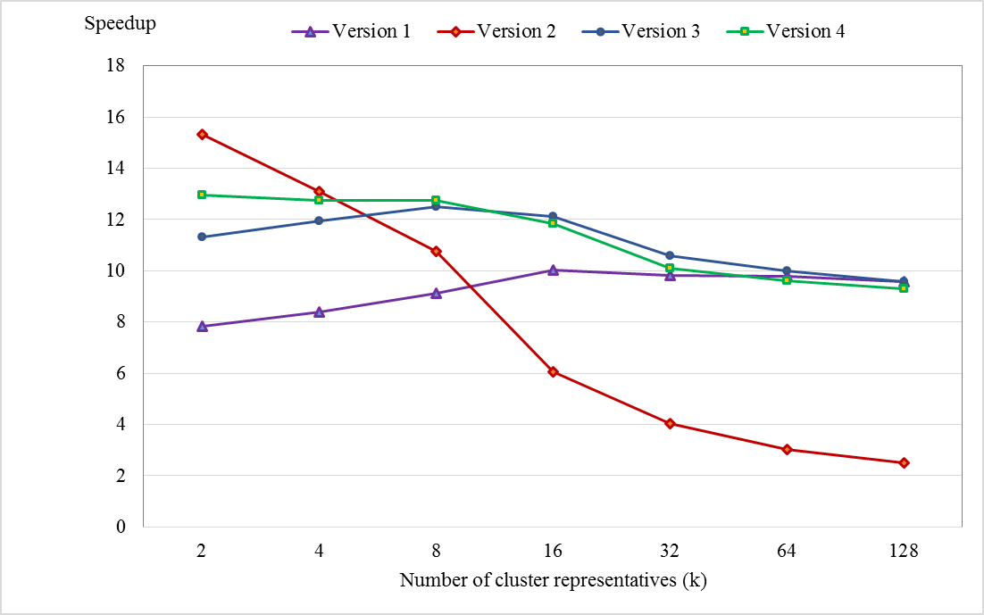
Experimental Results
Third test : changing speedup with various k on “poker” data set with N = 1025100, d = 10, M = 2, ε = 1e-8, maximum iterations = 200.

Slide 30
Experimental Results
Fourth test : changing speedup with various d on “Synthetic” data set with N = 491520, M = 2, k = 8, ε = 1e-8, and maximum iterations = 200.

Slide 31


Slide 32
Thank You

